Slide 1






KONGU ENGINEERING COLLEGE
PERUNDURAI ERODE-638060
ARTIFICIAL INTELLIGENCE AND MACHINE LEARNING
KEC IDEATHON
Uncovering Hidden Losses:A guide to Non-Revenue Water reduction
Team Lead: PRADAKSHINA S B
Team Members: YOGANANTH J
NITHISH N
Technology Readiness Level: IDEA (TRL-0)
Mentor : MS V SARANYAH (AI)
In association with:

Slide 2



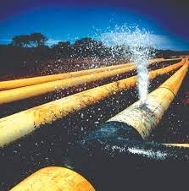
The Problem
The increasing levels of NON REVENUE WATER in India.
Non-revenue water (NRW) is water that has been produced and is "lost" before it reaches the customer.

Slide 3
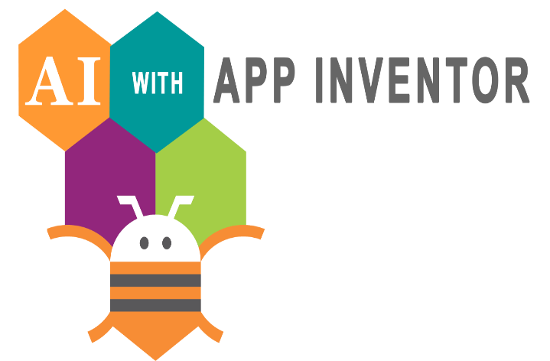
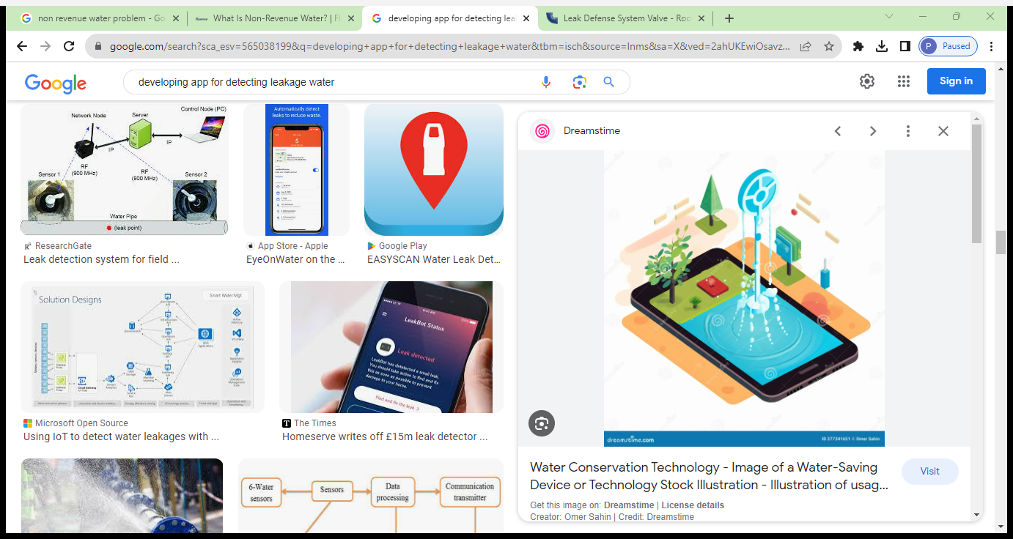
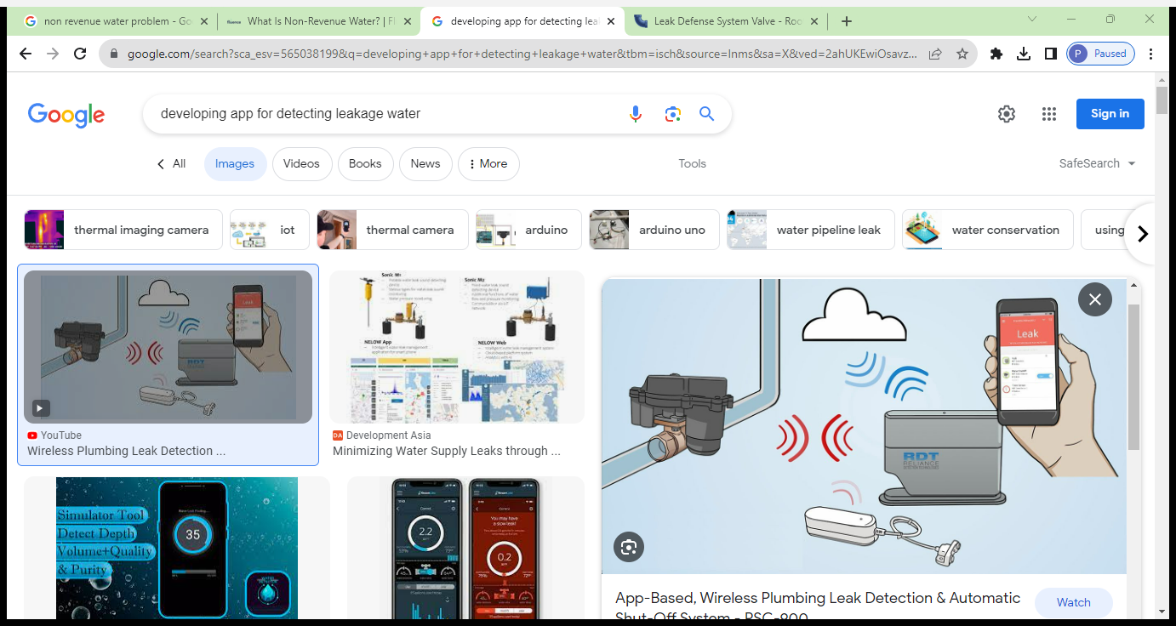
The Solution
Developing an app that maps all the pipelines and detect the leakage and reports the problem. Open to all people so that anyone can report leakages to us.

Slide 4
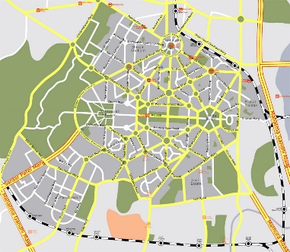

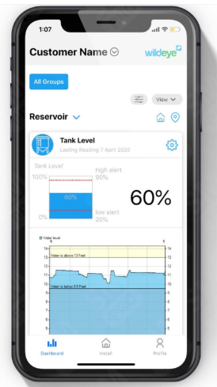
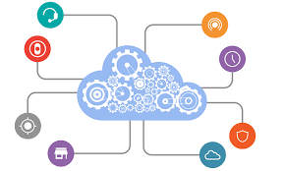
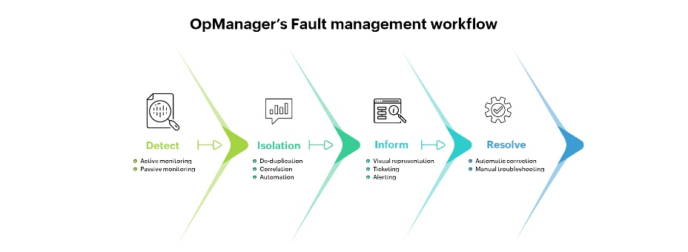
WHAT OUR APP DOES?
Mapping of Pipelines
Communication with people
Calculate the amount of NRW
Connectivity to smartmeter
Detection of faults in pipeline

Slide 5
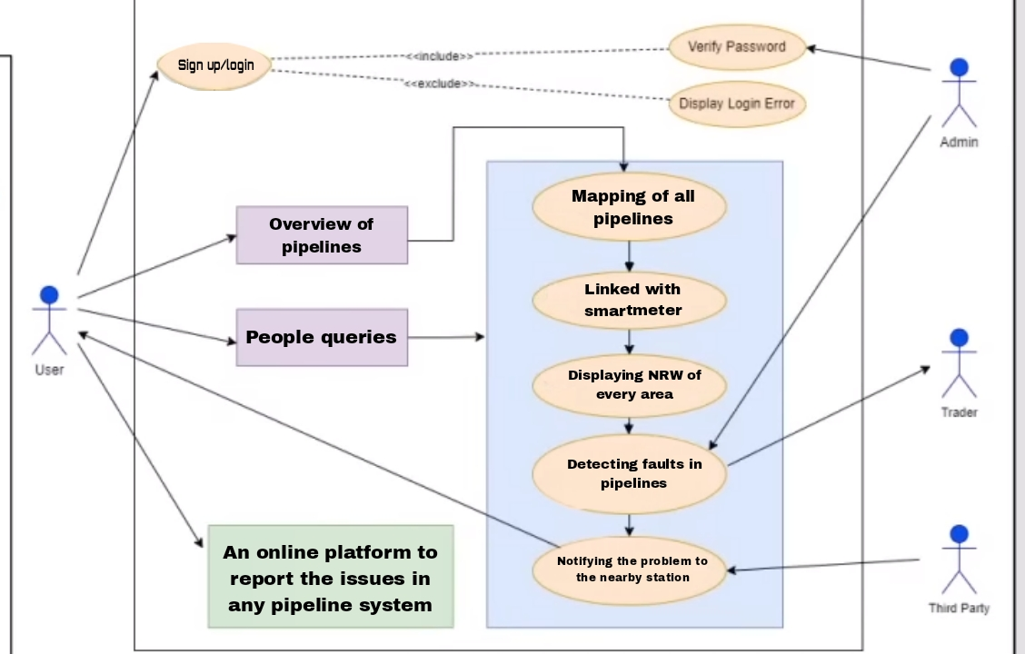
Product workflow

Slide 6


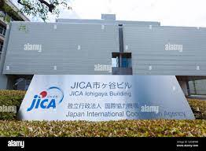
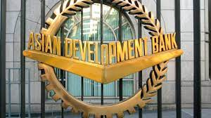
Competitors
Japan International Corporation Agency
PPIAF
Asian Development Bank

Slide 7
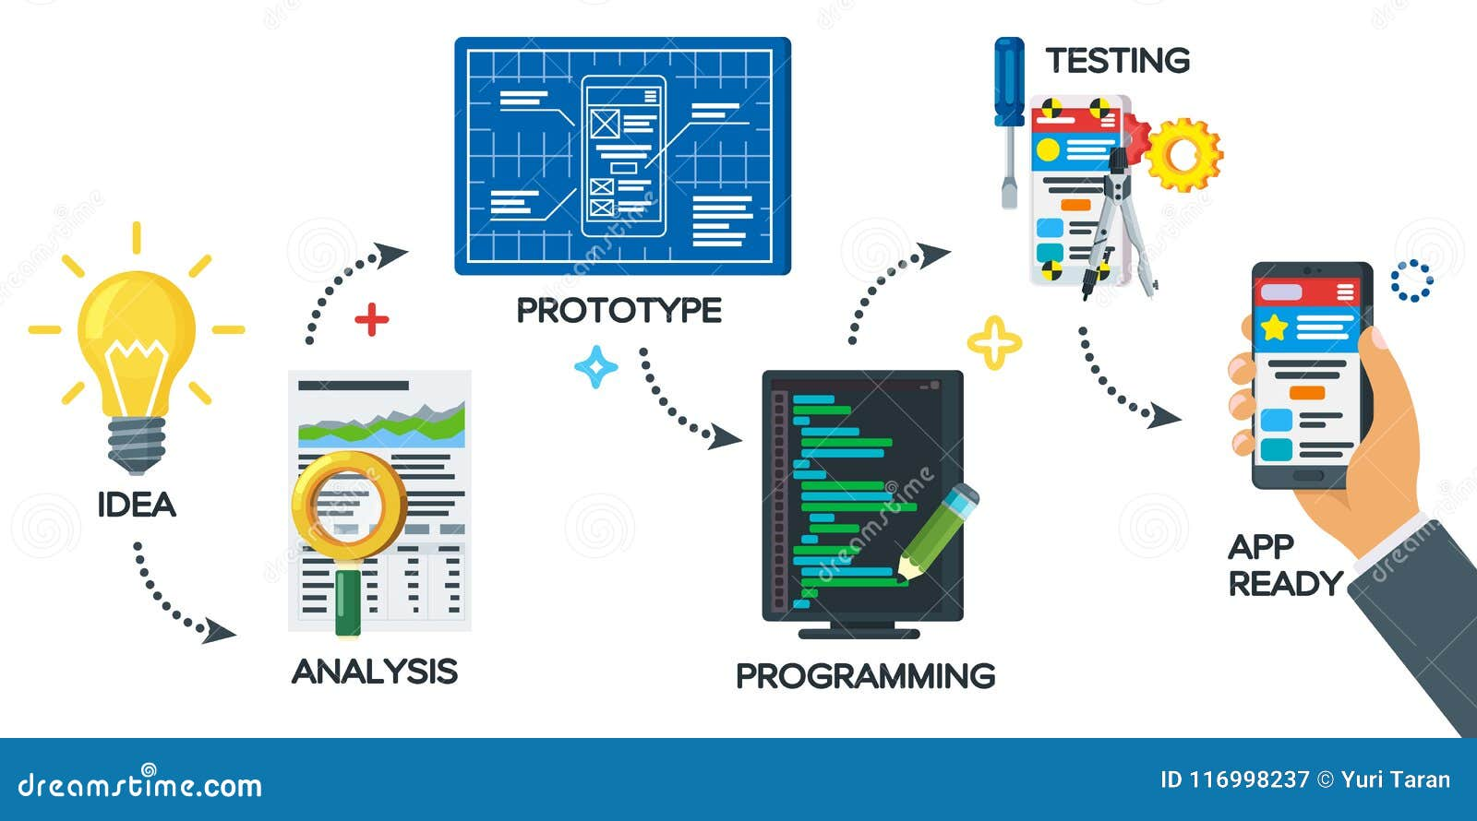
Uniqueness / IP & Value Proposition
This app only has the ability to map all the pipelines of India and identify the leakages that are happening. This is an unique app that can identify and reduce the Non Revenue Water.
The other people who have tried this project does not have the detailed overview or solution for NRW

Slide 8
Idea - Current Status / Future Plan Timeline & Milestones
CURRENT SITUATION OF THE PROBLEM:
The problem of NRW is not being addressed by most people and people are not aware of the problem .Eventhough NRW is not a big issue if noticed on streets,after longterm this problem causes many financial problem and water loses in various places.
AFTER THIS APP:
If we detect the flaws in the pipelines and solve the faults we can reduce the NRW risks upto 60%.Non-revenue water (NRW) accounts for about 20% of the total water supply in India. We can reduce this to a 6-12% of the total water supply.

Slide 9
Thank You !!

